Slide 1
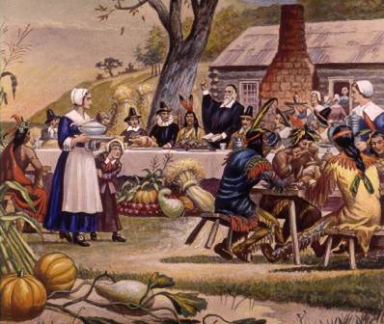
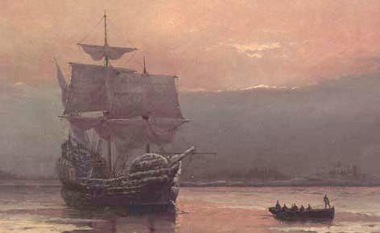
SSUSH1 The student will describe European settlement in North America during the 17th century.

Slide 2
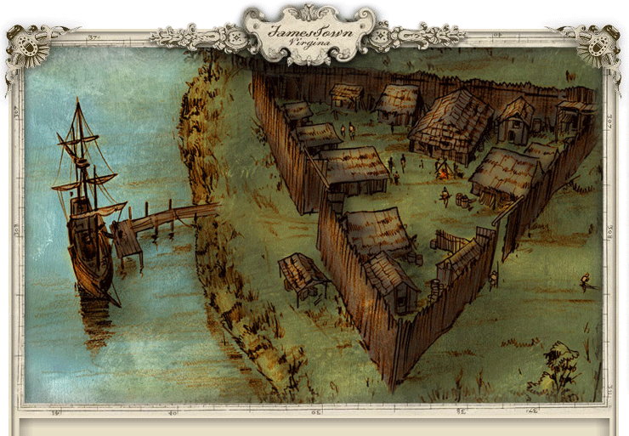
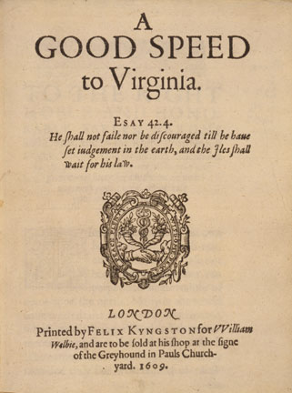
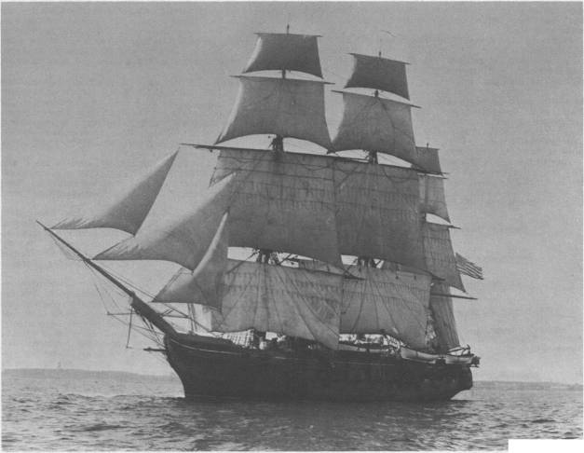
SSUSH1a: Explain Virginia’s development; include the Virginia Company, tobacco cultivation, relationships with Native Americans such as Powhatan, development of the House of Burgesses, Bacon’s Rebellion, and the development of slavery.

Slide 3
Virginia (1a)
The first permanent English colony in North America was Virginia.
It was a business venture of the Virginia Company, an English firm that planned to make money by sending people to America to find gold & other valuable natural resources & then ship the resources back to England.
The Virginia Company established a legislative assembly that was similar to England’s Parliament, called the House of Burgesses.
The House of Burgesses was the first European-type legislative body in the New World & the first representative legislative body in the New World.

Slide 4
Virginia (1a)
People were sent from England to work for the Virginia Company.
They discovered no gold but learned how to cultivate tobacco. John Rolfe proved it could be profitable.
Tobacco quickly became a major cash crop & an important source of wealth in Virginia.
It also helped to create major social & economic divisions between those who owned land & those who did not.
Additionally, tobacco cultivation was labor-intensive, & the Virginia colony’s economy became highly dependent on slavery.

Slide 5
Labor in Virginia
Virginia (1a)
settlement was encouraged by “headright system”: gave 50 acres of land to any settler who came to VA
encouraged wealthy to bring over more indentured servants
Indentured servants work for a set number of years to repay the person who paid for them to come to the colonies
1619 first Africans arrive, most likely as indentured servants

Slide 6
Virginia (1a)
Virginia’s rich soil, temperate climate, coastal harbors, & river systems aided the colony’s growth, especially the Jamestown settlement.
Easy access to commercial waterways allowed colonists to export tobacco & other natural resources to England, as well as to import much-needed manufactured goods from English markets.
The trans-Atlantic trade made it possible for the colony to prosper and expand.

Slide 7
Virginia (1a)
Native Americans had lived for centuries on the land the English settlers called Virginia.
A notable Native American chieftain in the region was Powhatan.
Soon after the English settlers arrived, they forced the Native Americans off their own land so it could be used by the settlers for agricultural purposes, especially to grow tobacco.
Their actions caused many Native Americans to flee the region & seek new places to live.
However, all the colonists did not own land.

Slide 8
Virginia (1a)
Poor English and slave colonists staged an uprising against the governor & his landowning supporters.
In what is called Bacon’s Rebellion, the landless rebels wanted harsher action against the Native Americans so more land would be available to the colonists.
The rebellion was put down, & the Virginia House of Burgesses passed laws to regulate slavery so poor white colonists would no longer side with slaves against rich white colonists.

Slide 9
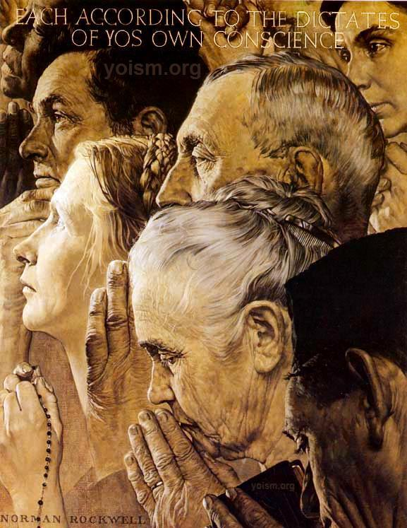
SSUSH1b: Describe the settlement of New England; include religious reasons, relations with Native Americans [e.g., King Phillip’s War], the establishment of town meetings and development of a legislature, religious tensions that led to the founding of Rhode Island, the half-way covenant, Salem Witch Trials, and the loss of the Massachusetts charter and the transition to a royal colony.

Slide 10
New England (1b)
The first New England colonies were established by the Puritans in present-day Massachusetts.
Most of the colonists came with their whole family to pursue a better life & to practice religion as they saw fit.
As a result of strict religious beliefs, the Puritans were not tolerant of religious beliefs that differed from their own.
Rhode Island was founded by religious dissenters from Massachusetts who were more tolerant of different religious beliefs.

Slide 11
New England (1b)
Communities were often run using town meetings, unless the king had established control over the colony.
In colonies that the king controlled, there was often an appointed royal governor & a partially elected legislature.
Voting rights were limited to men who belonged to the church, & church membership was tightly controlled by each minister & congregation.

Slide 12
New England (1b)
As more & more children were born in America, many grew up to be adults who lacked a personal covenant (relationship) with God, the central feature of Puritanism.
In response, Puritan ministers encouraged a “Half-way Covenant” to allow partial church membership for the children and grandchildren of the original Puritans.

Slide 13
New England (1b)
King Phillip’s War (1675–1676) was an early and bloody conflict between English colonists & Native Americans.
It was named after the leader of the Native Americans.
King Phillip’s Native American name was Metacom.
Many colonists died in the war, but it caused such a heavy loss of life among the Native American population that large areas of southern New England became English settlements.

Slide 14
New England (1b)
In 1686, the British king canceled the Massachusetts charter that made it an independent colony.
To get more control over trade with the colonies, he combined British colonies throughout New England into a single territory governed from England called the Dominion of New England.
The colonists in this territory greatly disliked this centralized authority.
In 1691, Massachusetts Bay became a royal colony.

Slide 15
New England (1b)
In the 1690s, the famous Salem witch trials took place.
In a series of court hearings, over 150 Massachusetts colonists accused of witchcraft were tried, 29 of which were convicted & 19 hanged.
At least six more people died in prison.
Causes of the Salem witch trials included extreme religious faith, stress from a growing population & its bad relations with Native Americans, & the narrow opportunities for women & girls to participate in Puritan society.

Slide 16
SSUSH1c: Explain the development of the mid-Atlantic colonies; include the Dutch settlement of New Amsterdam {New York} and the subsequent English takeover, and the settlement of Pennsylvania.
Pennsylvania, located between New England and Virginia, was a colony founded by the religiously tolerant Quakers led by William Penn.
William Penn wants it to be a “Holy Experiment” with complete religious freedom

Slide 17
Mid-Atlantic Colonies (1c)
Farther north, New York was settled by the Dutch, who called it New Amsterdam.
In 1664, the British conquered the colony & renamed it New York.
A diverse population kept alive this center of trade & commerce founded by the Dutch, whom the British invited to remain there.
The Dutch were the first to introduce Africans to the colonies
With members of various British & Dutch churches, New York also tolerated different religions.

Slide 18
New York’s harbor & river systems significantly contributed to its economic growth and importance.
New York’s convenient location along water trade routes allowed farmers to easily ship wheat & other agricultural goods to markets in America & in Europe, as well as to import manufactured goods from markets abroad.
This allowed New York to grow into a major commercial hub & one of the biggest cities in the British colonies.
Mid-Atlantic Colonies (1c)

Slide 19
SSUSH1d: Explain the reasons for French settlement of Quebec.
France, like its European rival, Great Britain, settled colonies to secure the valuable natural resources of North America & export them to Europe.
Quebec was the first permanent French settlement in North America.
Became a fur trading center (as did most of their settlements)

Slide 20
Quebec (1d)
The French instructed their colonists to spread the Catholic faith in the New World.
The British encouraged their colonists to establish Protestantism, but the British were more interested in the wealth of natural resources the colonists could send back to Britain.
Still, the reason many British colonists moved to the New World was for the opportunity to establish societies tolerant of, & built on, their own religious beliefs.

Slide 21
SSUSH1e: Analyze the impact of location and place on colonial settlement, transportation, and economic development; include southern, middle, and New England colonies.

Slide 22
Location and Place - Geography
New England
Geographic features of land encouraged creation of small family farms [No need for slaves]
Establishment of churches and towns built around church congregations
Colonists had little to trade to “Mother” country/England so precedent of illegal trading/smuggling common in New England – precedent of commerce and business
Religious intolerance led to creation of other colonies
Religious sentiment led to view of slavery as evil

Slide 23
Location and Place - Geography
Virginia and the South
Geographic features of land encouraged creation of large farms/plantations to cultivate cash crops/ tobacco
Colonists main trading partner “Mother” country/England so plantations located near rivers to transport cash crops to England
Religious hypocrisy led to view of slavery as good for “savages”
Economic greed led to view of slavery as necessary

Slide 24
Location and Place - Geography
Mid-Atlantic Colonies
Geographic features of land encouraged creation of wheat farms
Colonists main trading partner other colonies and then Mother England – need for infrastructure to bring goods to eastern/southern colonies
Proximity to Native Americans led to peaceful coexistence between colonists and American Indians
Tolerance was a key characteristic in Philadelphia and New York – led to diversity of cultures

